Slide 1

DS4LAW
Workshop 1: Algorithms (foundations)
Kody Moodley, PhD.
The Faculty of Law & The Institute of Data Science @ Maastricht University

Slide 2
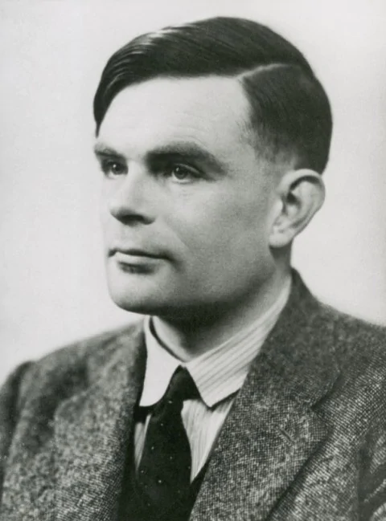


A little about me
Born and bred in South Africa
Trained as a Computer Scientist
BSc & MSc in Pretoria
PhD in Manchester
Industry - creating algorithms (mobile applications)
1st Postdoc in Maastricht
“In theory, there is no difference between theory and practice, in practice, there is.” - Jan L. A. Van De Snepscheut (Caltech)

Slide 3
A little about you?
Brief introduction (name & affiliation)
What is your interest: DS4LAW or LAW4DS?
Experience with algorithms
What you hope to gain from the session

Slide 4
Aims
Basic literacy of algorithms in the context of Computer Science
LAW4DS:
Understanding mechanisms of algorithms can aid formulation of good questions about their regulation
Intuition for distinguishing between true & apparent algorithmic intelligence
DS4LAW:
Theoretical foundations of algorithms & role in computer science
Basic practical experience with creating & implementing algorithms

Slide 5
Roadmap
Mostly talking
Part 1A: Algorithms are all around us...but what exactly are they?
Part 1B: Algorithms in Computer Science
Part 2: Real examples of algorithms
Part 3: Ethical significance of algorithms
Mostly doing
Python programming in Jupyter notebooks
Write and test some algorithms!

Slide 6
Part 1A
Algorithms are all around us...but what are they?

Slide 7
Definition for Algorithm
“a set of rules that must be followed when solving a particular problem.”
- Oxford Learner’s Dictionary
“A set of specific, step-by-step instructions for taking an input and converting [it] into an output.”
- John Danaher, The Philosophical Importance of Algorithms, 2015.
In short: “a set of step-by-step instructions for executing a task.”

Slide 8

Examples
Making a peanut butter & jelly sandwich
Get a piece of bread
Spread peanut butter on it
Get another piece of bread
Spread jelly on it
Put the two pieces of bread together
Who is issuing the instructions?
Who is executing the instructions?
What are the inputs & outputs of the algorithm?
Notes:
Is there enough information for a computer to execute this algorithm?

Slide 9

Examples
Shampooing hair
Anything strange about this algorithm?
Who is issuing the instructions?
Who is executing the instructions?
What are the inputs & outputs
of the algorithm?
Notes:
No terminating condition. Computers don’t have common-sense.

Slide 10
Part 1B
Algorithms in Computer Science

Slide 11


Slide 12

Route finding algorithms

Slide 13

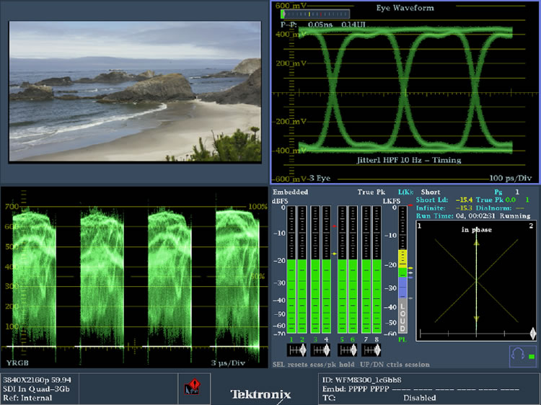
Audio & Video compression algorithms

Slide 14
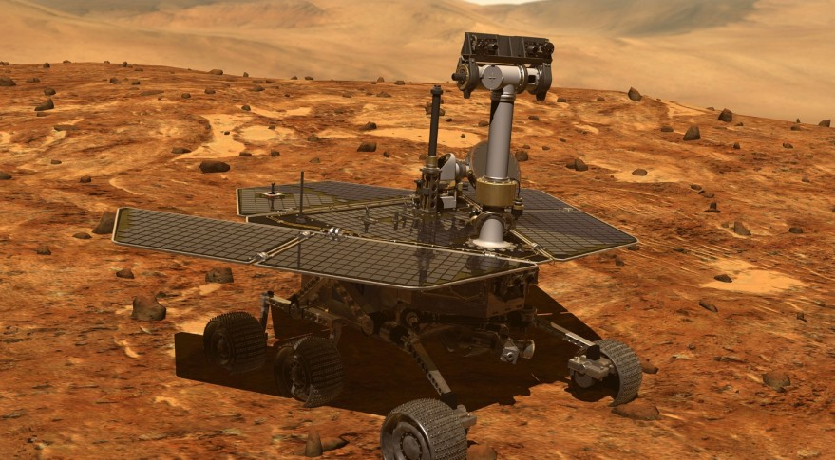


Optimisation & scheduling algorithms

Slide 15
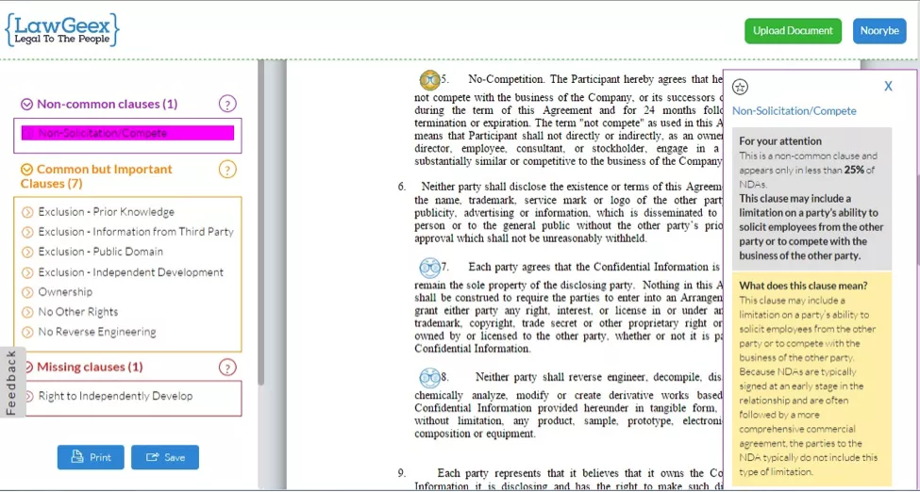
Contract review using Machine Learning algorithms

Slide 16
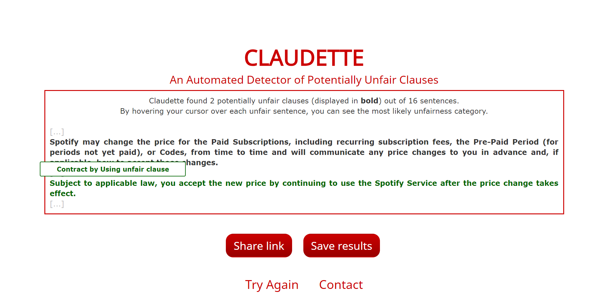
Unfair clause detection using Machine Learning

Slide 17



Algorithms in Computer Science
Who is issuing the instructions? Humans
Who is executing the instructions? Computers
?

Slide 18



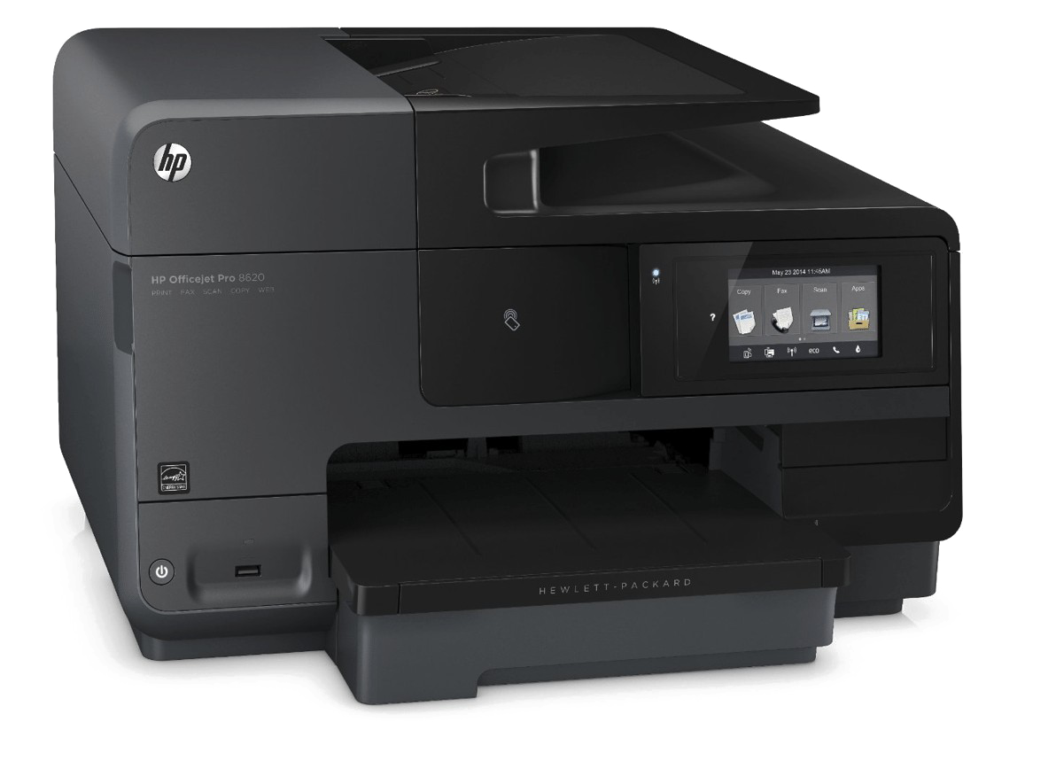

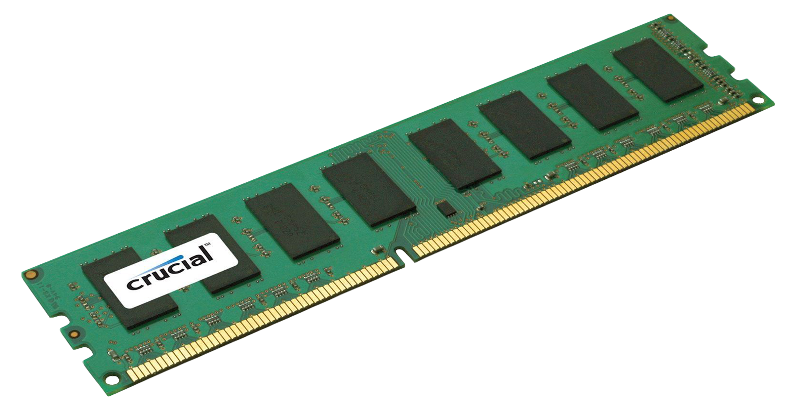

Computer Architecture
Central Processing Unit
(CPU)
Input devices
Output devices
Memory Unit
(Primary & Secondary)

Slide 19
Computer Architecture
Input devices
Memory Unit
(Primary)
STORAGE
23 + 34?
1
2
3
Value: “23” | Instruction: “add(1,3)” | Value: “34”
... | ... | ...
How many bits does a computer with 4GB of RAM have?
0 | 0 | 1 | 0 | 0 | 0 | 1 | 0
0 | 0 | 0 | 1 | 0 | 1 | 1 | 1
0 | 0 | 1 | 0 | 0 | 0 | 0 | 0
“34”
Each block represents the charge of a single capacitor in memory
“23”
“add(1,3)”
2⁷ 2⁶ 2⁵ 2⁴ 2³ 2² 2¹ 2⁰

Slide 20
Computer Architecture
COMPUTATION
Fetch instruction from memory location 2
Execute instruction:
Load the first number into the CPU
Add the second number to this number
Store the sum in memory location 4
0 0 1 0 0¹ 0¹1 0
0 0 0 1 0 1 1 1
_________________
0 0 1 1 1 0 0 1
Central Processing Unit
(CPU)
Fetch/Put
1
2
3
4
Memory Unit
(Primary)
Value: “23” | Instruction: “add(1,3)” | Value: “34” | Value: “57”
... | ... | ...

Slide 21
Computer Architecture
Modern computers using Turing’s model of computation
Described by a Turing machine
Any algorithm that you can conceive of and execute as a human being, can be represented as a set of operations in a Turing machine.

Slide 22
Example (square root)
What is the square root of a given number?
Put input number here
(1) | (2) | (3) | (4) | (5)
Try it out with “9”!
Write 0 in box (2)
Increment (2)
Write 0 in box (3)
Copy number in (2) to box (4)
If box (4) contains 0, go to step 12.
Decrement (4)
Copy number in (2) to box (5)
If box (5) contains 0, go to step 5.
Decrement (5)
Increment (3)
Go to step 8.
If number in (3) not greater than number in (1), go to step 2.
Decrement (2)
Notes:
Not intuitive...

Slide 23
Programming languages
Machine code
(1’s and 0’s)
Python
C/C++
Higher-level
Lower-level
Natural language
Java
Assembler

Slide 24
Programming languages
Python
Java
Assembler
Machine code
a = 83
b = -2
c = a + b
int a, b, c;
a = 83;
b = -2;
c = a + b;
ORG 100
LDA A
ADD B
STA C
HLT
A,DEC 83
B,DEC –2
C,DEC 0
END
0010 0001 0000 0100
0001 0001 0000 0101
0011 0001 0000 0110
0111 0000 0000 0001
0000 0000 0101 0011
1111 1111 1111 1110
0000 0000 0000 0000
“Installing” a programming language on your computer means you are providing your OS with instructions on how to convert instructions specified in that language into Machine code. These algorithms are called Compilers or Interpreters.

Slide 25
Part 2
Real examples of algorithms

Slide 26
Find the largest number in a list
Judge name | Number of cases
Ilešič | 266
Jann | 280
Schockweiler | 251
Moitinho de Almeida | 272
Toader | 263
Rosas | 284
Silva de Lapuerta | 252
Gulmann | 255

Slide 27
Find the largest number in a list
Number of cases
266
280
251
272
263
284
252
255
Input: ?
Output: ?
Instructions: ?

Slide 28

Find the largest number in a list
Number of cases
266
280
251
272
263
284
252
255
Input: list of numbers e.g. 266,280,251,272,263,284,252,255
Output: largest number in the list e.g. 284
Outline of algorithm:
Assume the first number in the list is the largest
Consider each number in the list one-by-one from top to bottom
While we do this, if the current number being looked at is larger than the current largest number, consider this number to be the new largest
Stop when we get to the end of the list

Slide 29
Sort a list of numbers from smallest to largest
Number of cases
266
280
251
272
263
284
252
255
Input: ?
Output: ?
Instructions: ?

Slide 30
Sort a list of numbers from smallest to largest
Number of cases
266
280
251
272
263
284
252
255
Input: list of numbers e.g. 266,280,251,272,263,284,252,255
Output: list of numbers sorted ascending order e.g.
251,252,255,263,266,272,280,284
Outline of algorithm:
Create a new empty list
Find smallest number in input list and add it to end of the new list
Remove number in previous step from input list
Repeat Steps 2 and 3 until input list is empty

Slide 31
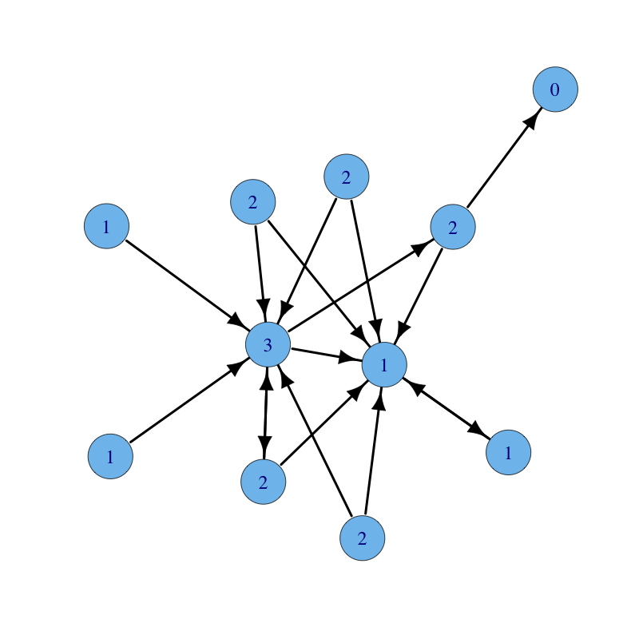
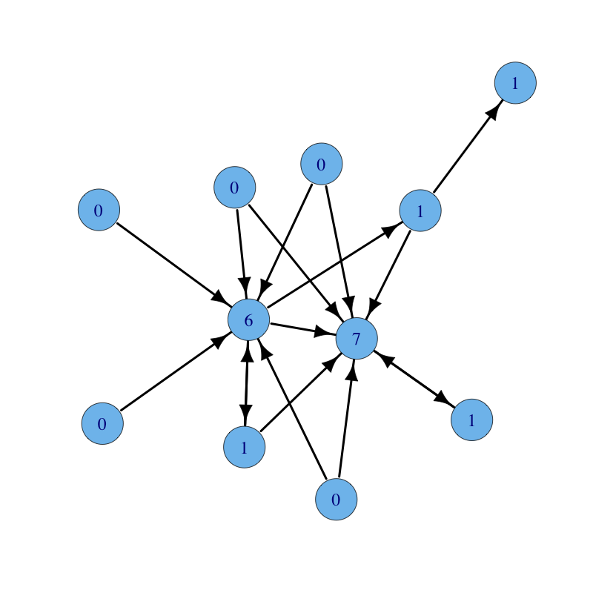
Network Analysis
x
y
e
int calculate_indegree(graph g, vertex v):
count = 0
for each e in g.getAllEdges():
if e.y == v:
count++
return count
int calculate_outdegree(graph g, vertex v):
count = 0
for each e in g.getAllEdges():
if e.x == v:
count++
return count
Nodes = court decisions
Edges = citations

Slide 32
Part 3
Ethical significance of algorithms

Slide 33

Algorithm transparency
“Algorithms are not arbiters of objective truth and fairness simply because they're math.” - Zoe Quinn
Transparency is a challenge with more complex algorithms (especially with ML)
Decision-making algorithms (implications for liability)
Vs. Algorithms used in decision-making
Dichotomy: what an algorithm actually does and what it is claimed or advertised to do (BEWARE OF HYPE - the truth is often far less impressive)

Slide 34
Algorithms using deductive vs. inductive reasoning
Bob likes hockey
Bob has a systolic pressure reading of 150
His favourite colour is green
He works for the US Navy
Bob’s father, Daniel, was admitted to hospital in 1999 with a systolic pressure reading of 180
Daniel also worked for the US Navy
Anna was chief of cardiology in the general hospital
Daniels father took medication for hypertension
Bob’s mother, Anna, had a normal systolic pressure reading of 110
Systolic pressure readings between 100 - 120 are normal, anything above 120 is considered high
Having hypertension, and a family history of it, means you are at risk of a heart attack
If you have high systolic pressure, it means that you have hypertension
Is Bob at risk of a heart attack?

Slide 35
Algorithms using deductive vs. inductive reasoning
Bob likes hockey
Bob has a systolic pressure reading of 150
His favourite colour is green
He works for the US Navy
Bob’s father, Daniel, was admitted to hospital in 1999 with a systolic pressure reading of 180
Daniel also worked for the US Navy
Anna was chief of cardiology in the general hospital
Daniels father took medication for hypertension
Bob’s mother, Anna, had a normal systolic pressure reading of 110
Systolic pressure readings between 100 - 120 are normal, anything above 120 is considered high
Having hypertension, and a family history of it, means you are at risk of a heart attack
If you have high systolic pressure, it means that you have hypertension
Is Bob at risk of a heart attack?
YES!
Deduction

Slide 36
Algorithms using deductive vs. inductive reasoning
I saw three swans at the park
All three were black
I will go to the zoo tomorrow to see more swans
What colour will they be?

Slide 37
Algorithms using deductive vs. inductive reasoning
I saw three swans at the park
All three were black
I will go to the zoo tomorrow to see more swans
What colour will they be?
Black (probably)
UNCERTAINTY, Lack of complete information
Induction (a form of generalisation)

Slide 38
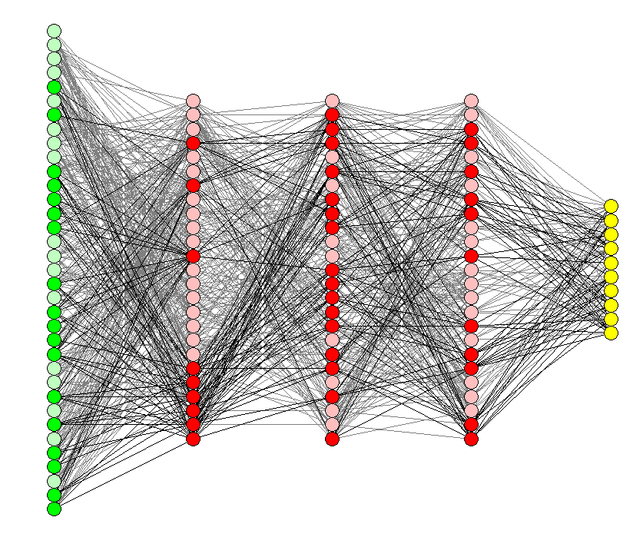
Algorithms using deductive vs. inductive reasoning
Hidden layers
Will I get cancer?
Input layer
Output layer
Yes / No
Height, weight, blood sugar levels, blood type, genetic data etc.

Slide 39
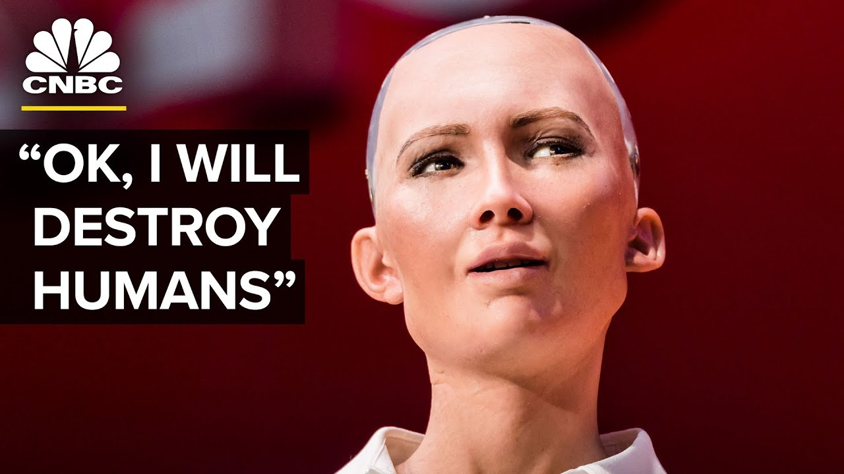
if question about humans:
if person is smiling:
say:
“OK, I will destroy humans”

Slide 40

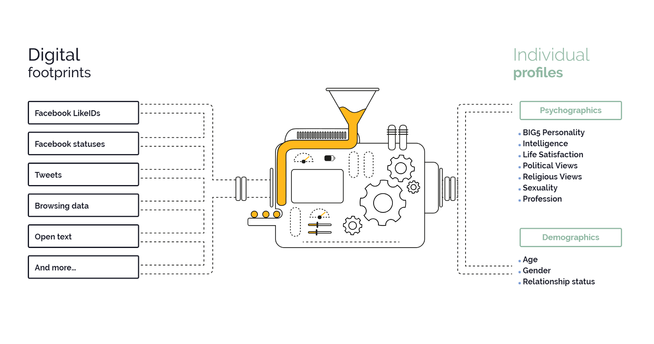
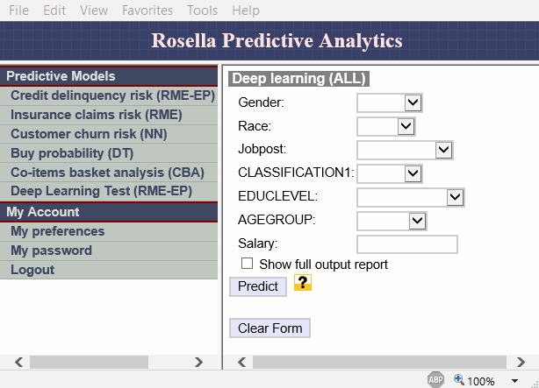

Ethical application of algorithms
“Just because you can, does not mean you should”

Slide 41
Summary
Algorithms are step-by-step instructions for executing a task
Issuing algorithmic instructions to computers requires a special language:
Computers, on their lowest-level, are only able to manipulate data represented in a binary language (0’s and 1’s)
Humans have created ‘high-level’ programming languages to help us communicate with computers more concisely
Compilers (algorithms for translating instructions from ‘high-level’ programming languages into computer language) make ‘high-level’ communication with computers possible
Algorithms are usually developed in a modular way so they can be reused in other algorithms

Slide 42
Summary (cont.)
Algorithms can be classified according to the problems they try to solve as well as the kinds of procedures used to solve them
Ethical issues with algorithms are affecting society:
Lack of transparency in the algorithm’s steps (e.g. Machine Learning)
Uncertainty in information doesn’t stop attempts to predict (with algorithms)
Fundamental questions of whether algorithms (and automation in general) should be applied to solve certain problems (social implications etc.)

Slide 43
Practical
Jupyter notebook reference
Jupyter notebook online (without installing)

Slide 44
Resources
Computer Science & programming foundations
edX computer science & programming mooc
Udemy Python course
Datacamp Python course
Data Science textbook - Nice one!

